Slide 1

Model Evaluation

Slide 2
Objectives
Apply ridge regression to regularize and reduce the standard errors to avoid overfitting a regression model
Apply grid search techniques to Python data
Model Evaluation

Slide 3
Ridge Regression
Ridge regression is a regression that is employed in a Multiple regression model when Multicollinearity occurs.
Multicollinearity is when there is a strong relationship among the independent variables.
Ridge regression is very common with polynomial regression.
Ridge regression prevents overfitting.
Model Evaluation

Slide 4
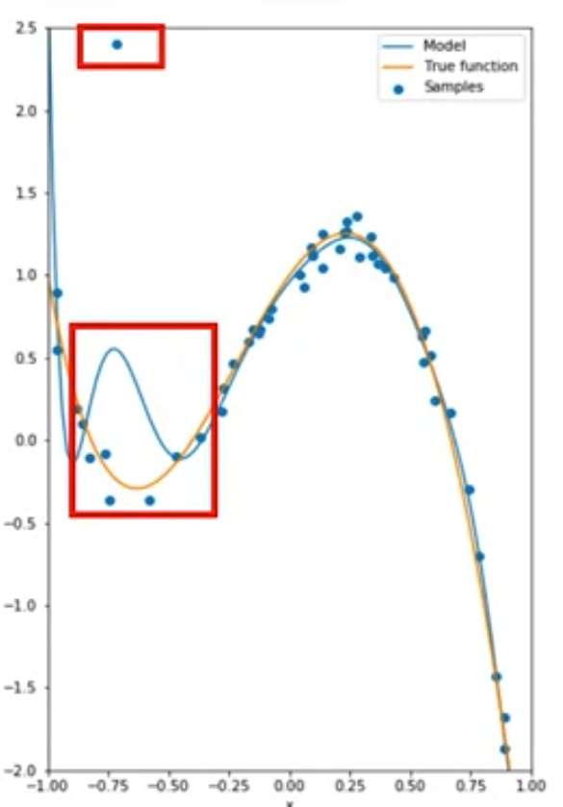

Ridge Regression
Ridge regression problem:
What is it?
Model Evaluation
Notes:
Consider the following fourth order polynomial in orange.
The blue points are generated from this function.
We can use a tenth order polynomial to fit the data.
The estimated function in blue does a good job at approximating the true function.
In many cases real data has outliers.

Slide 5
Ridge Regression
estimated polynomial coefficients have a very large magnitude.
This is especially evident for the higher order polynomials.
Ridge regression controls the magnitude of these polynomial coefficients by introducing the parameter alpha.
Alpha is a parameter is selected before fitting or training the model
Model Evaluation

Slide 6
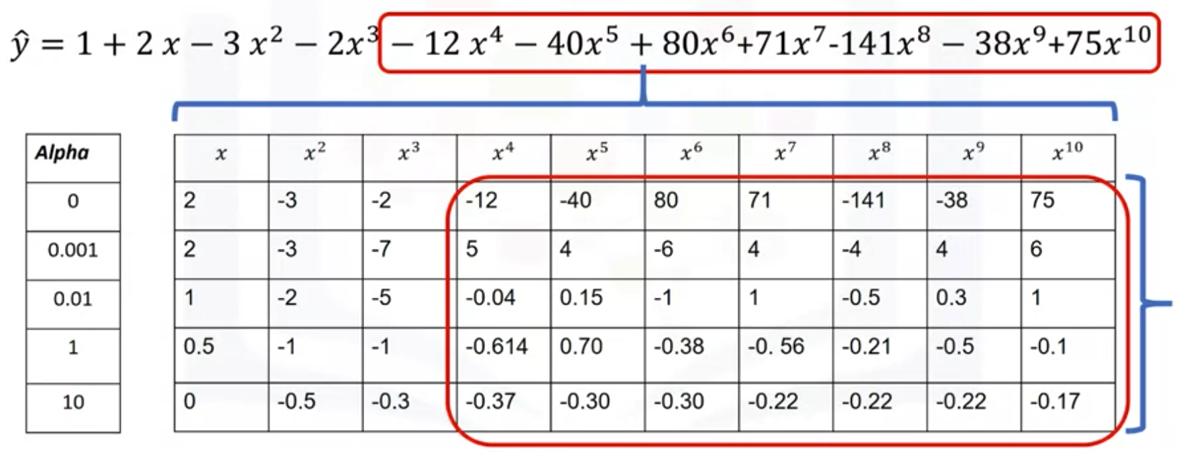
Ridge Regression
How different values of alpha change the model.
This table represents the polynomial coefficients for different values of alpha
Model Evaluation

Slide 7
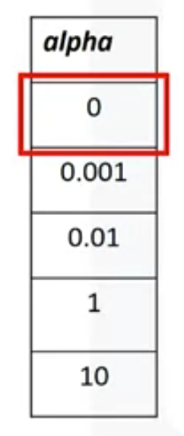
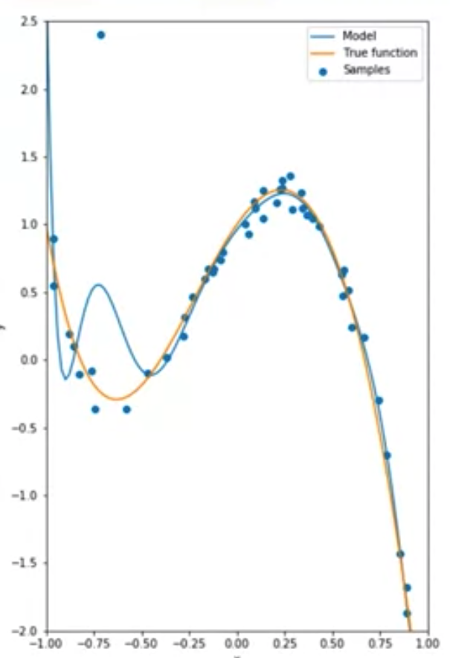
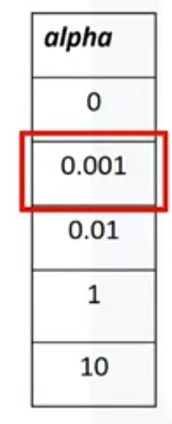
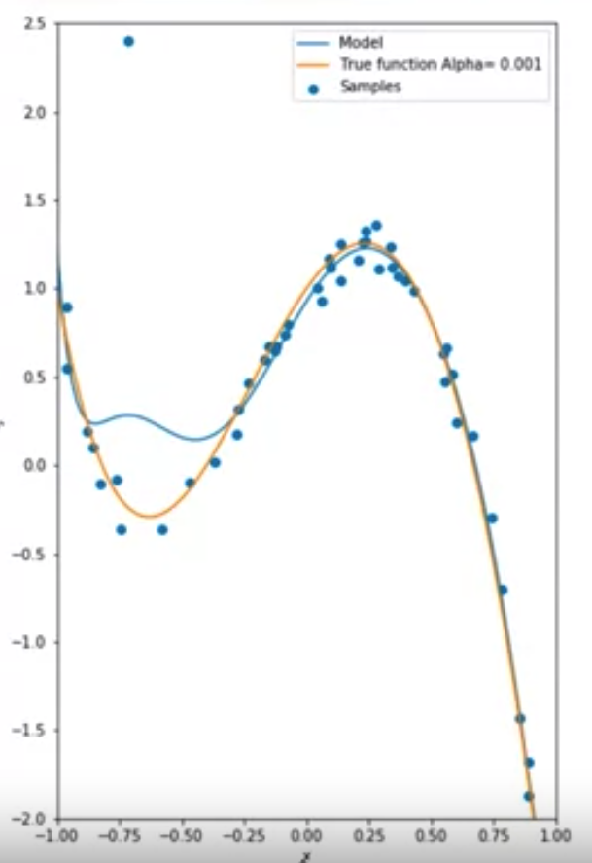
Ridge Regression
overfitting is evident
overfitting begins to subside
Model Evaluation

Slide 8
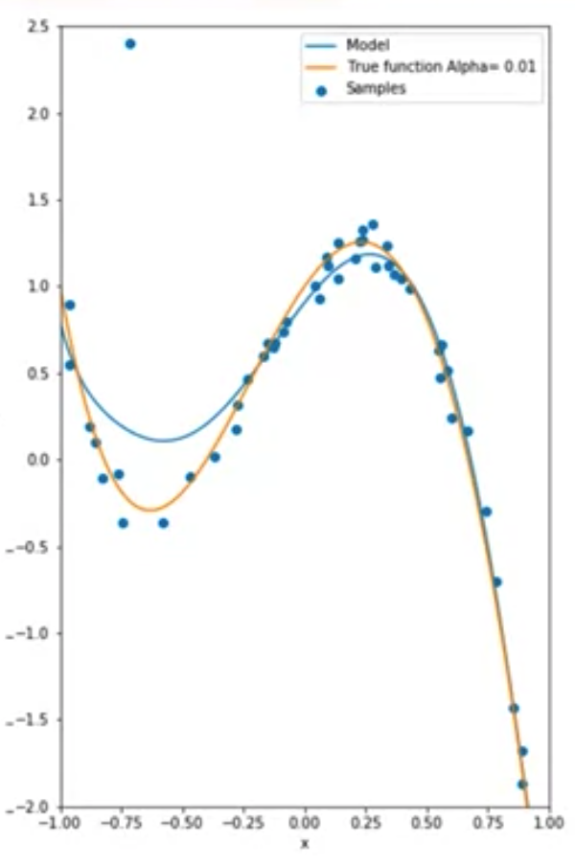
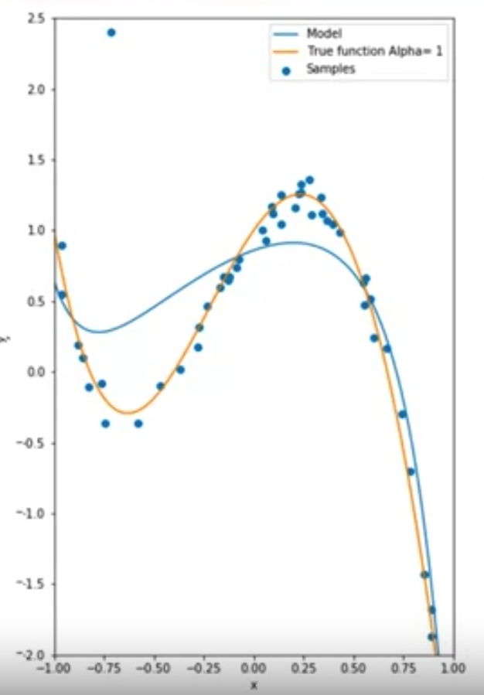
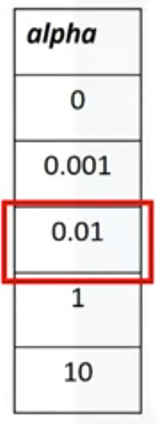
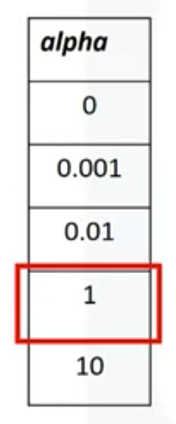
Ridge Regression
the estimated function tracks the actual function
the first signs of underfitting
Model Evaluation

Slide 9
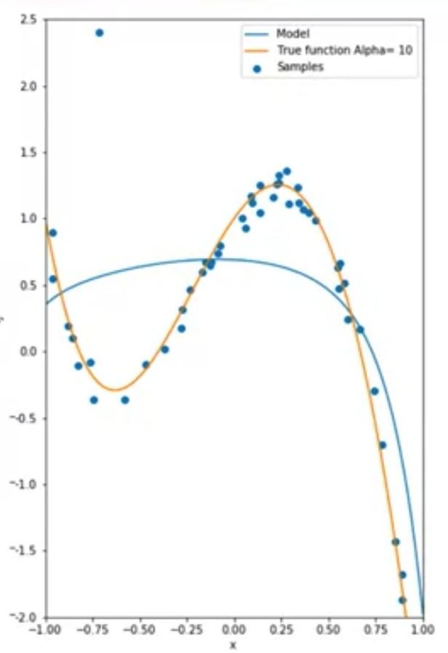
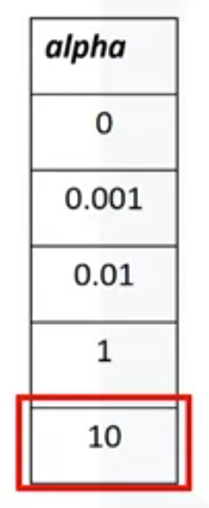
Ridge Regression
extreme underfitting
Model Evaluation

Slide 10
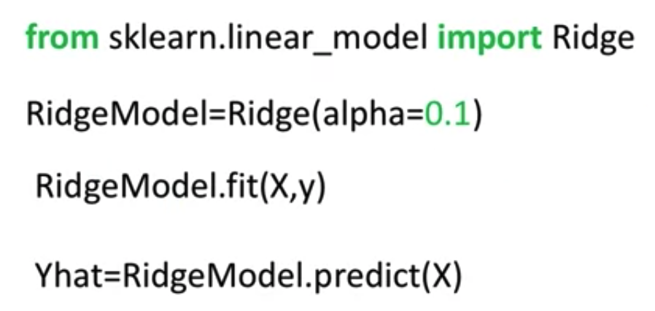
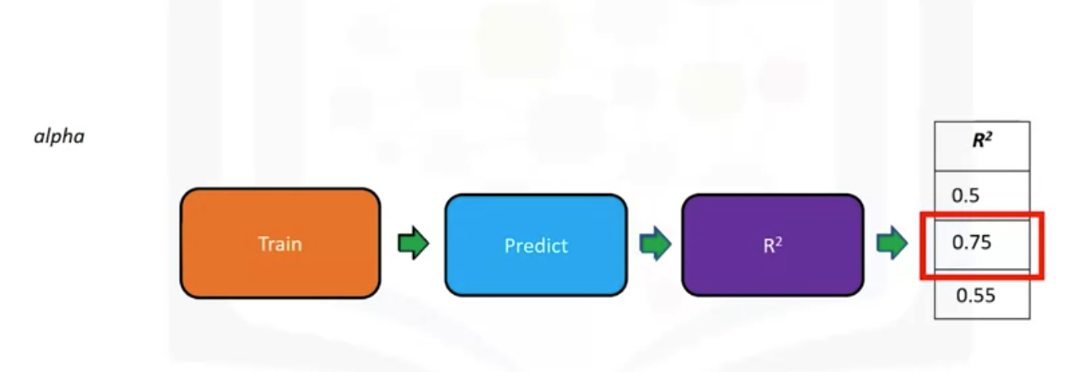
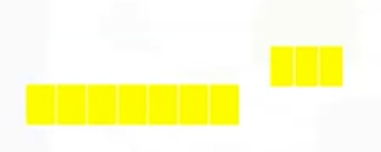
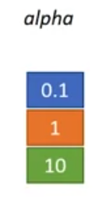
Ridge Regression
Python code
Train
data
Test
data
MSE
Model Evaluation

Slide 11
Grid Search
Grid Search allows us to scan through multiple free parameters with few lines of code.
The term alpha in Ridge regression is called a hyperparameter
Scikit-learn has a means of automatically iterating over these hyperparameters using cross-validation called Grid Search
Model Evaluation

Slide 12
Grid Search
The small circles represent different hyperparameters.
Each one value for hyperparameters and train the model.
Use different hyperparameters to train the model.
Continue the process until we have exhausted the different free parameter values.
Each model produces an error.
We select the hyperparameter that minimizes the error.
Model Evaluation

Slide 13
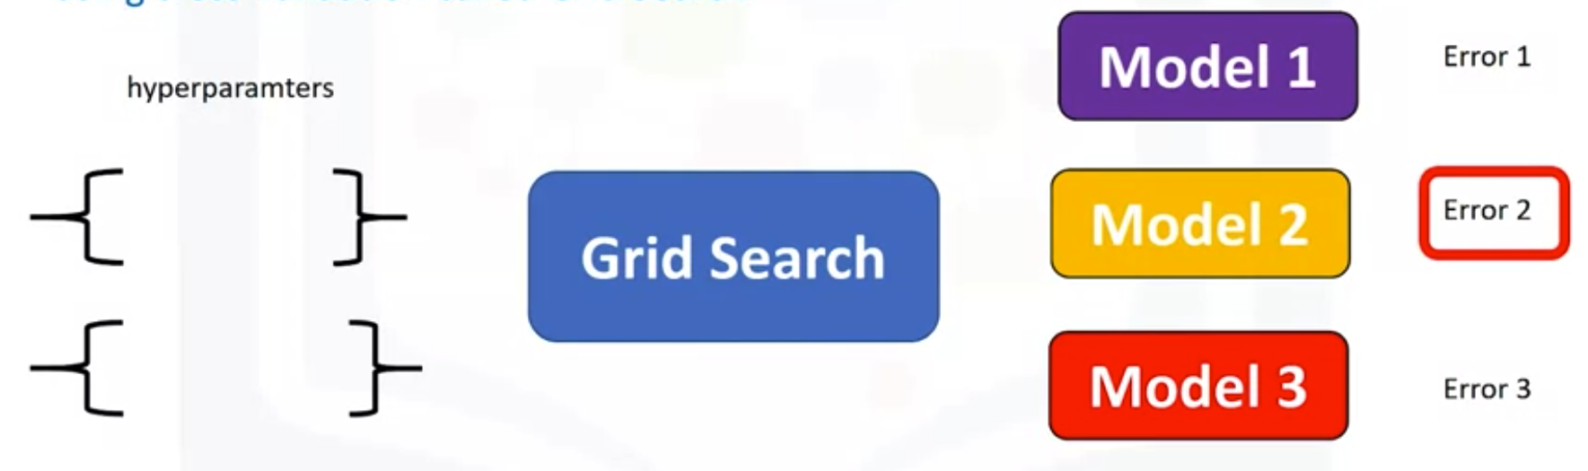
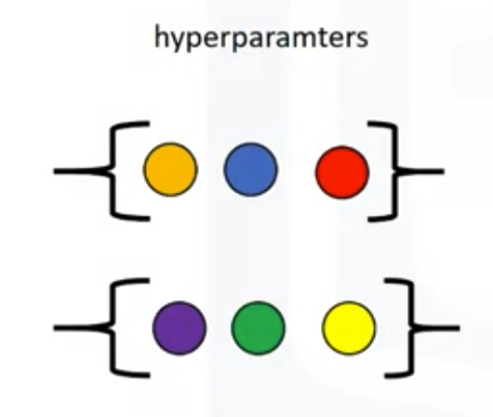
Grid Search
Model Evaluation
Notes:
The small circles represent different hyperparameters.
Each one value for hyperparameters and train the model.
Use different hyperparameters to train the model.
Continue the process until we have exhausted the different free parameter values.
Each model produces an error.
We select the hyperparameter that minimizes the error.

Slide 14
Grid Search
We select the hyperparameter that minimizes the error.
To select the hyperparameter: split our dataset into three parts, the training set, validation set, and test set.
Train the model for different hyperparameters. We use the R-squared or mean square error for each model.
Select the hyperparameter that minimizes the mean squared error or maximizes the R-squared on the validation set.
Finally test our model performance using the test data.
Model Evaluation

Slide 15
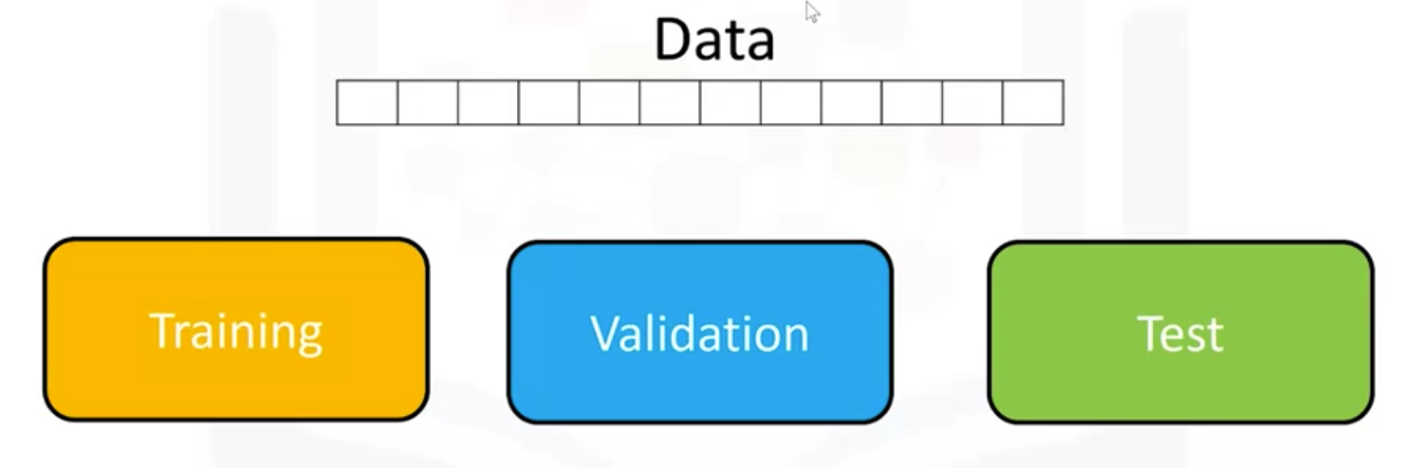
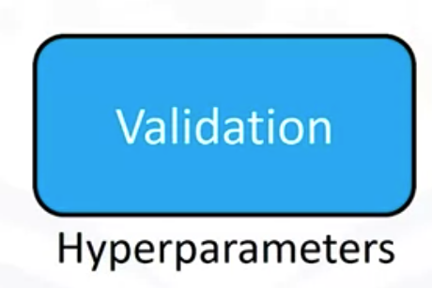
Grid Search
Model Evaluation

Slide 16
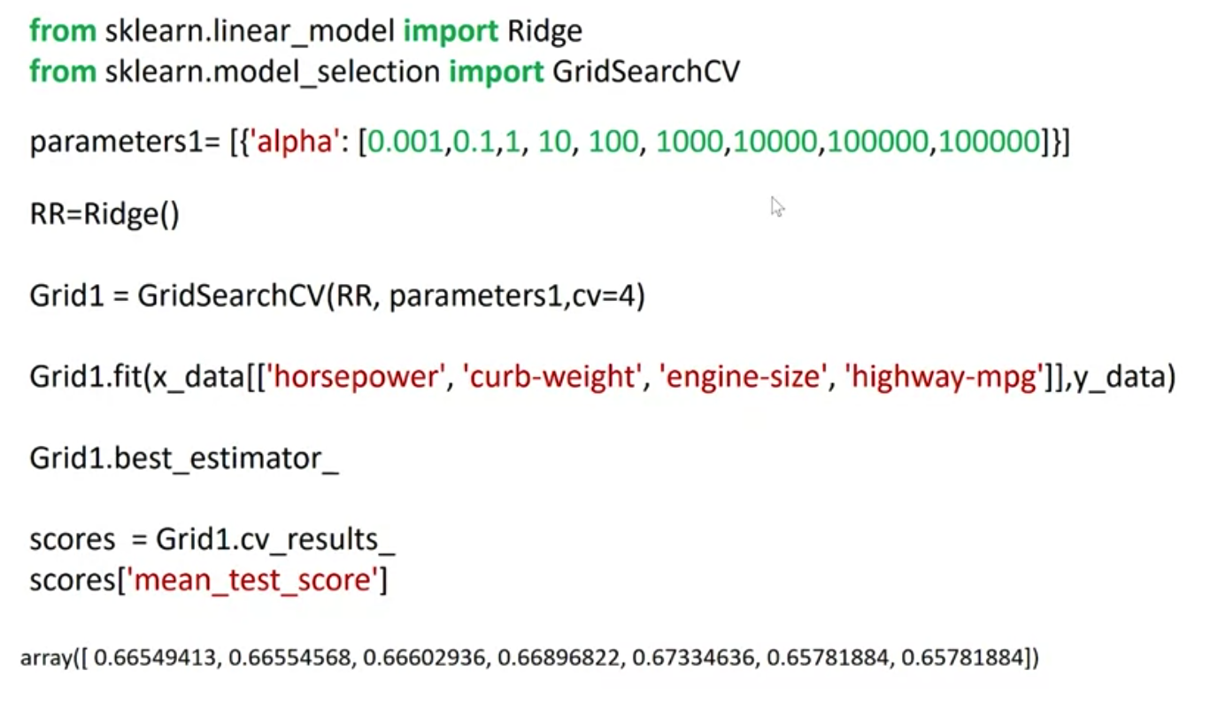
Grid Search
Model Evaluation
Notes:
First, we import the libraries we need, including GridSearchCV, the dictionary of parameter values. We create a ridge regression object or model. We then create a GridSearchCV object. The inputs are the ridge regression object, the parameter values, and the number of folds. We will use R-squared. This is the default scoring method. We fit the object. We can find the best values for the free parameters using the attribute best estimator. We can also get information like the mean score on the validation data using the attribute CV result. What are the advantages of Grid Search is how quickly we can test multiple parameters.

Slide 17
Summary
Apply ridge regression to regularize and reduce the standard errors to avoid overfitting a regression model
Apply grid search techniques to Python data
Model Evaluation

Slide 18
Q & A
Model Evaluation

